Slide 1
scRNA-seq Analysis
CDS-SR scRNA-seq Workshop 2022
(Part 1)
Seurat (Additional Downstream Analyses)
Slide 1

Slide 2
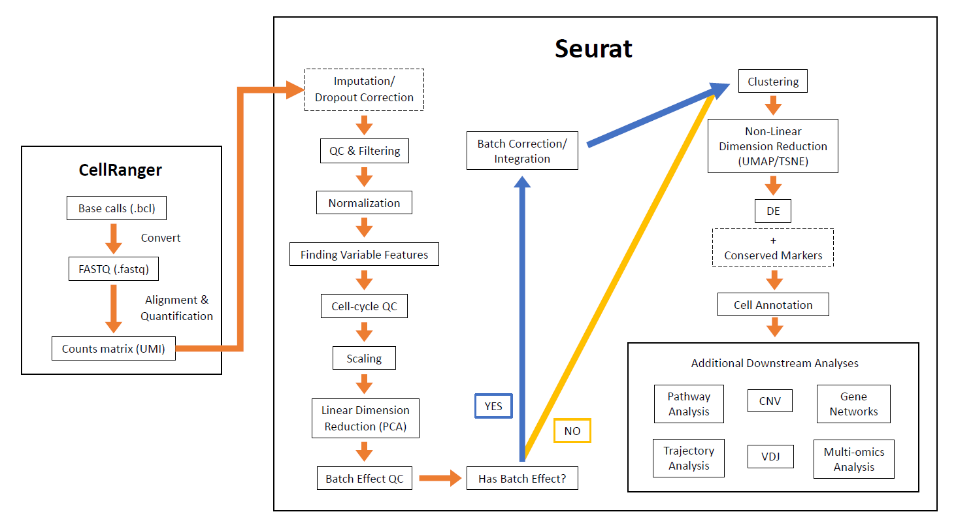
Full Analysis Pipeline
Slide 2

Slide 3
Additional Downstream Analyses
Many ways you can do to explore your data further
Cell Type Subpopulation Analysis
Pathway Analysis
Trajectory Analysis
Copy Number Variation Analysis (CNV)
VDJ Recombination Analysis
Gene Networks (also applicable to pathway analysis)
Multi-omics Analysis
Ligand-Receptor Analysis
THIS IS NOT ALL OF THEM
Slide 3
Notes:
There are many ways you can explore your data after the main pipeline
This is not all of the things you could do, but these are some that I have done or seen done before
I won’t talk about all of them in depth
Read all bullet points

Slide 4
Cell Type Subpopulation Analysis
Analyze a specific cell type in further detail
Initially, we found broad cell type categories
Myeloid, T, fibroblasts, epithelial, etc.
Ex: study myeloid cell sub-populations
Macrophages, neutrophils, mast cells, basophils, eosinophils, etc.
Need a good number of cells in specific population
# of cells > 20 at minimum (still might not work this low)
Slide 4
Notes:
Start off with cell type subpopulation analysis
call this subtyping
Read all bullet points

Slide 5
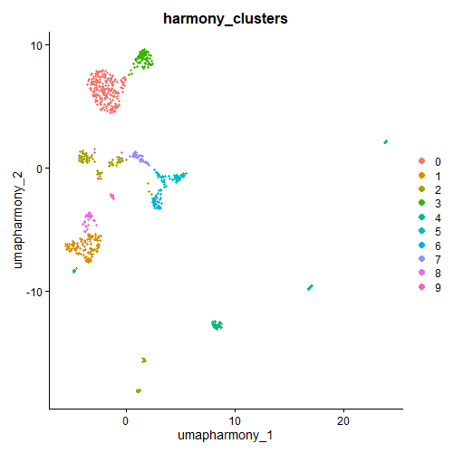
Cell Type Subpopulation Analysis
Fibroblast Subpopulations
Steps:
Subset cell type of choice
Re-run Seurat pipeline (normalization → UMAP)
Start at raw counts again
If you ran batch correction/integration, you WILL have to do this again for sub-analysis
Slide 5
Notes:
Go over how to do this
Use fibroblast population as an example
Read all bullet points
Explain plot on right

Slide 6
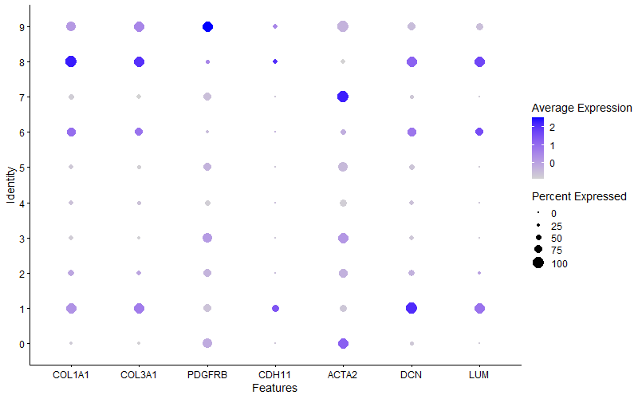
Cell Type Subpopulation Analysis
Steps:
Annotate new sub-cell types
Fibroblast Subpopulations
Slide 6
Notes:
Read all bullet points
Similar process as annotating before
look at specific markers to parse out subtypes
Dotplot of various fibroblast markers found in article

Slide 7
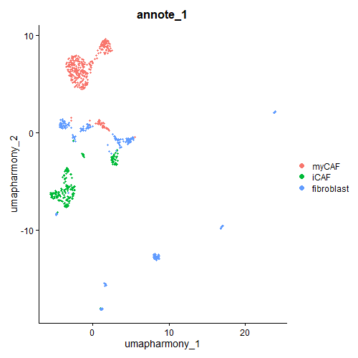
Cell Type Subpopulation Analysis
Fibroblast Subpopulations
Steps:
Annotate new sub-cell types
Slide 7
Notes:
After labeling the new clusters, UMAP looks like this
two main subtypes of fibroblasts

Slide 8
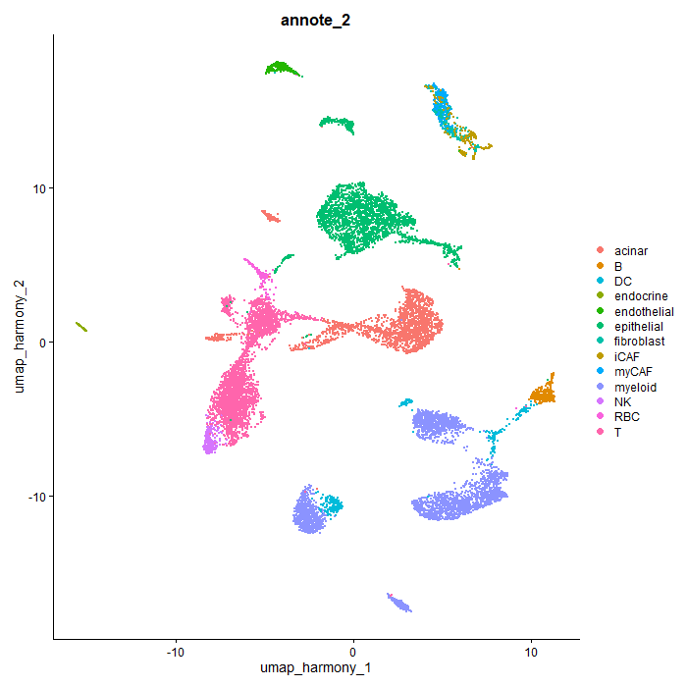
Cell Type Subpopulation Analysis
New UMAP with fibroblast sub-cell types
Additional steps can do after:
Re-transfer new labels to full dataset
Can see that some clusters will be split into subtypes
DE
Pathway analysis
Etc.
Slide 8
Notes:
Read first major bullet point
Read first sub bullet point
Explain plot on right
point out how fibroblast clusters are now split by subtype
Read rest of sub bullet points

Slide 9
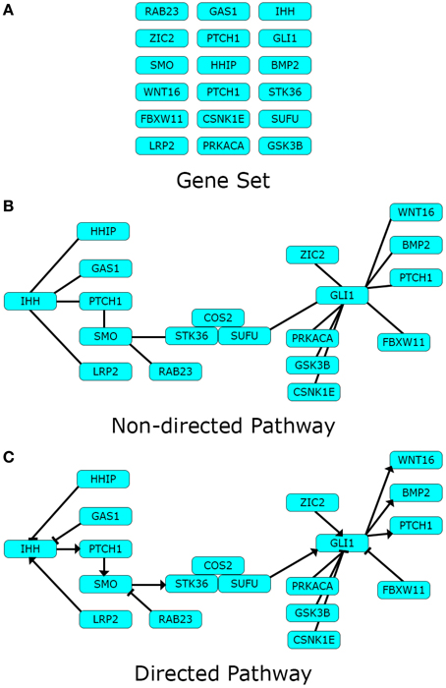
Pathway Analysis
Analyze groups of related genes between conditions
Helps to interpret large gene lists into biological concepts
Helps to interpretation of system and hypothesis generation
Used with many technologies
Bulk RNA, scRNA, ChIP, ATAC, microarray, etc.
https://www.frontiersin.org/articles/10.3389/fphys.2015.00383/full#:~:text=Pathway%20analysis%20is%20a%20set,statistical%20testing%20and%20other%20algorithms
Slide 9
Notes:
Common analysis
Read all bullet points

Slide 10
Pathway Analysis
ORA & FCS
Types of analyses
Over-representation analysis (ORA)
Functional class scoring (FCS)
Pathway-topology based (PTB)
PTB
https://www.frontiersin.org/articles/10.3389/fphys.2015.00383/full#:~:text=Pathway%20analysis%20is%20a%20set,statistical%20testing%20and%20other%20algorithms
Slide 10
Notes:
Read all bullet points and point them out in figures to right

Slide 11
Pathway Analysis
Over-representation analysis (ORA)
Find pathways where the proportion of genes within a given pathway exceeds the proportion of genes that could be randomly expected
Methods to calculate p-value
Hypergeometric distance, chi-square, binomial probability, Fischer’s exact test, etc.
Multiple testing correction is also applied
Benjamini and Hochberg (BH), Bonferroni, FDR, etc.
Can provide background gene list to compare against chosen gene list
Slide 11
Notes:
Simplest algorithm
Read all bullet points

Slide 12
Pathway Analysis
Over-representation analysis (ORA)
Example:
Threshold:
Upregulated = FC >= 2
Downregulated = FC <= -2
Take genes (not including FC) and run ORA
For upregulated and downregulated separately
Gene | FC
G1 | 4
G2 | 2
G3 | 1
…
G100 | -1
G101 | -2
G102 | -4
G1,G2
Upregulated
Pathways
Downregulated
Pathways
G101,G02
Slide 12
Notes:
Example of how ORA works

Slide 13
Pathway Analysis
Over-representation analysis (ORA)
Limitations
Must select cutoff
Have to run analysis for upregulated and downregulated pathways separately
Every gene in pathway is given equal weight/importance
Ignore information about gene expression level, position in path, interaction between genes
Assume paths are independent
Slide 13
Notes:
Read all bullet points

Slide 14
Pathway Analysis
Functional class scoring (FCS)
Changes in gene expression affect pathways
Gene Set Enrichment Analysis (GSEA)
Determine whether member of a gene set tends to occur toward the top/bottom of list
Gene sets are correlated with phenotype classes
Makes score based on the membership of genes in pathway and expression level
Look at supplemental slides at the end for information about GSEA algorithm
Use whole gene list
Slide 14
Notes:
Read all bullet points

Slide 15
Pathway Analysis
Functional class scoring (FCS)
For scRNA-seq, it’s easiest to work with pre-ranked lists
Due to values for every single cell per gene
Can use fold changes, p-values, customized scores, etc.
Slide 15
Notes:
Read all bullet points

Slide 16
Pathway Analysis
Functional class scoring (FCS)
Example:
Supply whole gene list with fold changes
Sorted from most positive to most negative
Creates score
Positive scores = upregulated
Negative scores = downregulated
Upregulated
Pathways
Pathway 1
Positive
Gene | FC
G1 | 4
G2 | 2
G3 | 1
…
G100 | -1
G101 | -2
G102 | -4
Score:
Pathway 1 = 2
Pathway 2 = -2.5
Pathway 3 = .01
Downregulated
Pathways
Pathway 2
Negative
Slide 16
Notes:
Example of GSEA

Slide 17
Pathway Analysis
Functional class scoring (FCS)
Advantages
No arbitrary threshold before running analysis
Uses expression information
How much is the pathway is changing?
Limitations
Can give same weight to all genes in path
Doesn’t take in account relationships between genes in path
Network structure
Assume paths are independent
Slide 17
Notes:
Read all bullet points

Slide 18
Pathway Analysis
Pathway-topology based (PTB)
Interactions found in topology help interpret changes between components
Extension of other 2 methods
Advantages
Topological information
Study upstream and downstream behaviors
Limitations
Some tools don’t take these into consideration:
Direction
Interconnections between pathways
Time and spatial distribution of genes
Multiple states and variants
https://www.frontiersin.org/articles/10.3389/fphys.2015.00383/full#:~:text=Pathway%20analysis%20is%20a%20set,statistical%20testing%20and%20other%20algorithms
Slide 18
Notes:
Read all bullet points

Slide 19
Pathway Analysis
Pathway databases
GO
KEGG
Reactome
MSIGDB
WikiPathway
Pathway Commons
STRING
And many more!
Slide 19
Notes:
Read all bullet points

Slide 20
Pathway Analysis
Tools:
Online (pay) = IPA, MetaCore, iPathway, etc.
Online/Application (free) = DAVID, PANTHER, Pathway Commons, GSEA, KEGG, Cytoscape, Enrichr, WebGestalt, STRING, etc.
R = clusterprofiler, WebGestalt, pathfinder, leapR, pathwayPCA, etc.
And many more!
Slide 20
Notes:
Read all bullet points

Slide 21
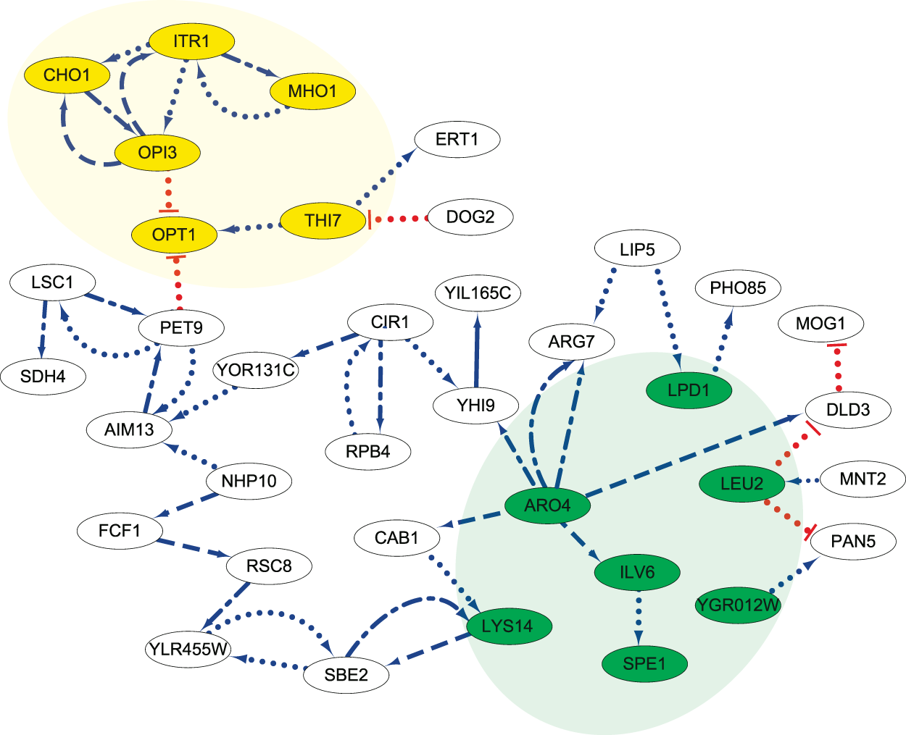
Gene Regulatory Networks (GRN)
Network that has been inferred from gene expression
Gene-gene or protein-protein interactions
Uses:
Causal map of molecular interactions
Experimental design and perturbation experiments
Biomarkers
Comparative network analysis
Medicine and drug design
Cell-type-specific network analysis
Look at supplemental slides at the end for information of different GRN algorithms
https://www.nature.com/articles/s41598-018-37667-4
Slide 21
Notes:
Read all bullet points
Explain plot on right

Slide 22
Gene Regulatory Networks (GRN)
Tools
C3Net
BC3Net
GENIE3
GGM
MI3
SCODE
GRNBoost
SCINET
STRING
Etc.
Slide 22
Notes:
Read all bullet points

Slide 23
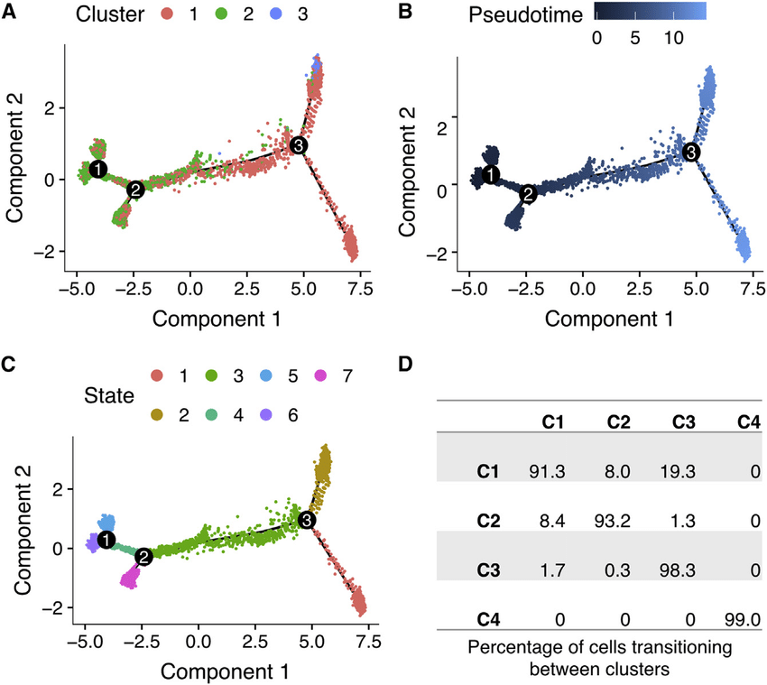
Trajectory Analysis
Trajectory analysis of endothelial lineage cells
Trajectory = collection of “lineages” for a process
Ex: differentiation, cell cycle, behavior of state in a system
Allocate cells to lineages and order them based on pseudotimes within lineages
https://www.researchgate.net/publication/339445945_Single-Cell_Transcriptional_Profiling_of_Aortic_Endothelium_Identifies_a_Hierarchy_from_Endovascular_Progenitors_to_Differentiated_Cells
Slide 23
Notes:
Read all bullet points
Explain plots on right

Slide 24
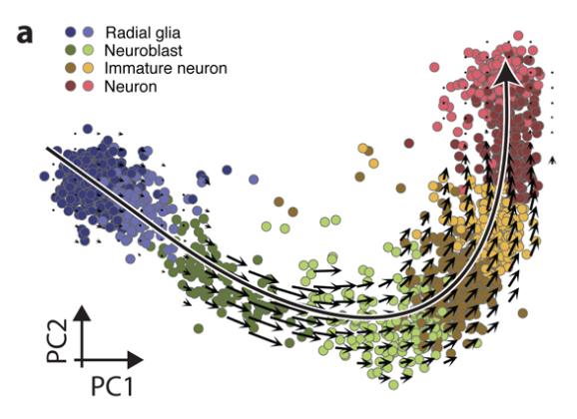
Trajectory Analysis
RNA velocity analysis of human
glutamatergic neurons
RNA velocity
Like pseudotime but also describes the direction and speeds
Estimated by unspliced and spliced mRNAs in scRNA-seq
https://www.ncbi.nlm.nih.gov/pmc/articles/PMC6130801/
Slide 24
Notes:
Read all bullet points
Explain plot on right and how it’s different than pseudotime

Slide 25
Trajectory Analysis
Tools
Slingshot
MST
Monocle
Wishbone
TSCAN
Wanderlust
Etc.
Slide 25
Notes:
Read all bullet points

Slide 26
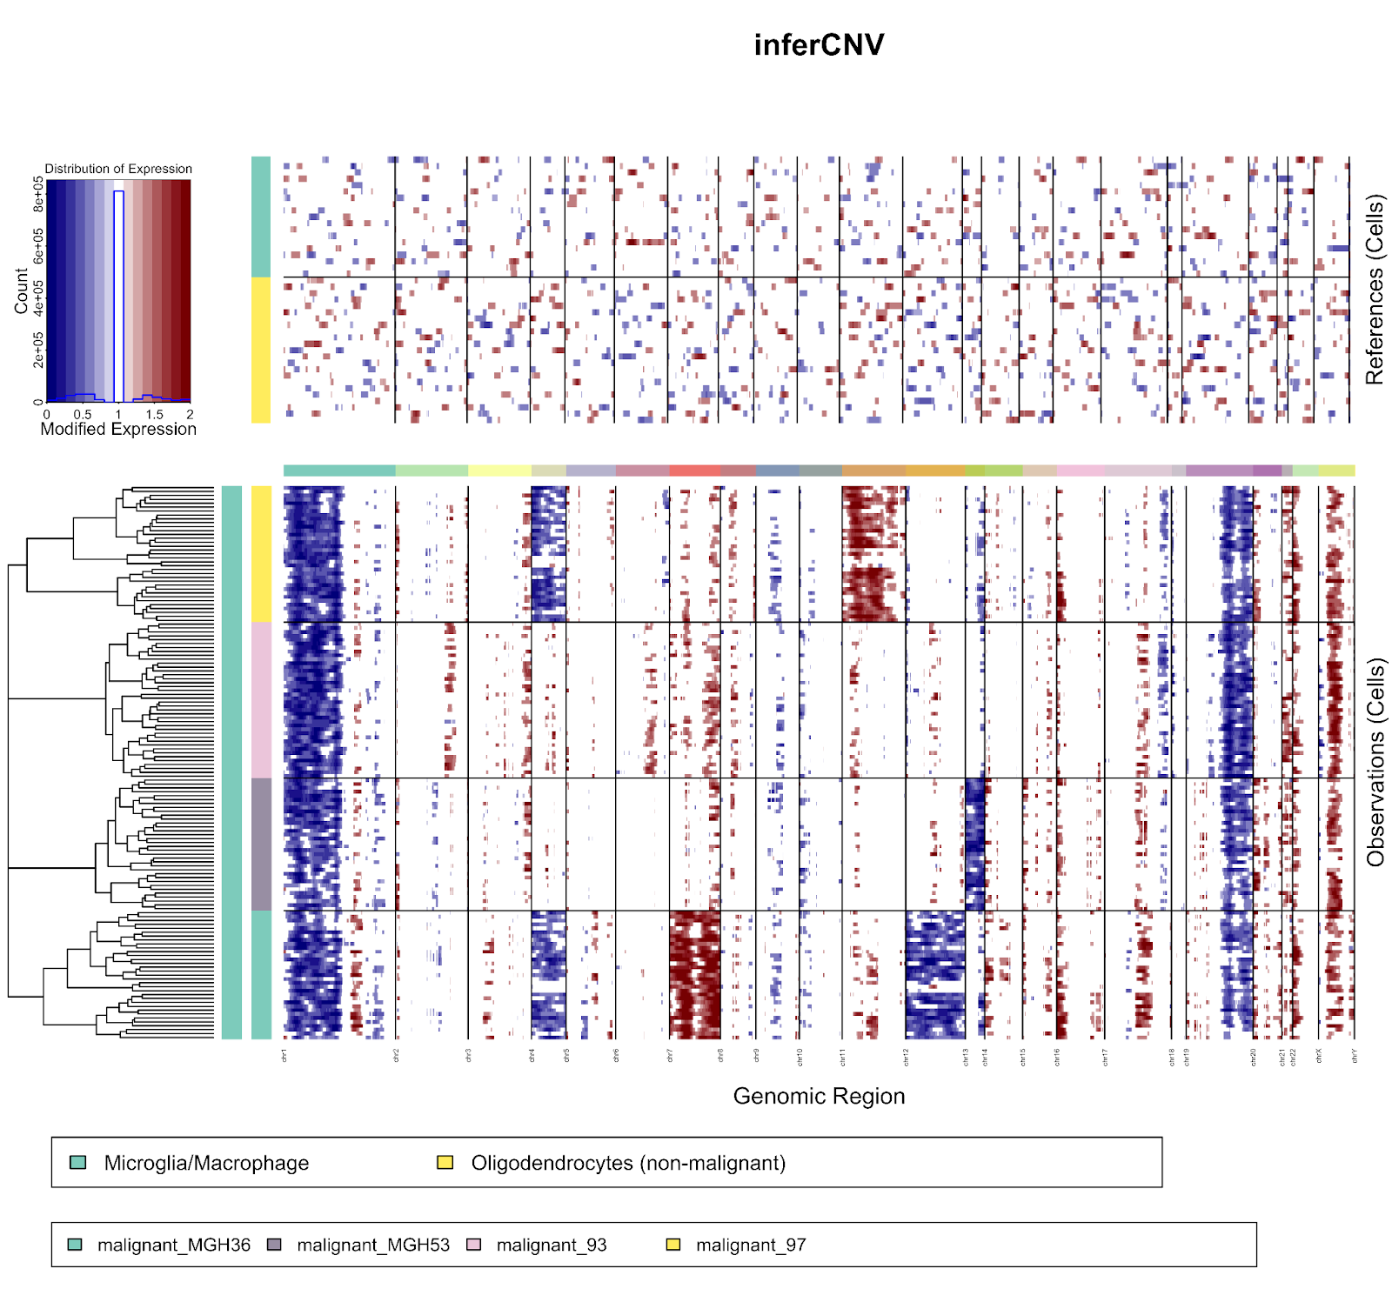
CNV
Normal cells
Identify somatic large-scale chromosomal copy number alterations
Tools
inferCNV (R and Shiny app)
= amplification
= deletion
Tumor cells
Slide 26
https://github.com/broadinstitute/inferCNV/wiki
Notes:
Read all bullet points
Explain plot on right

Slide 27
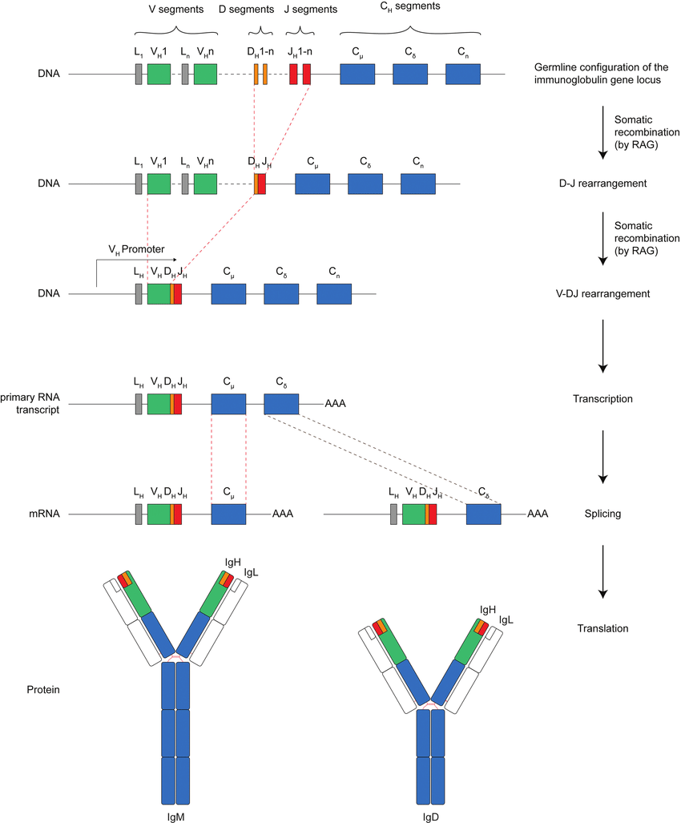
VDJ
Analyze mechanisms of genetic recombination in B and T cell populations
Need to run VDJ sequencing along with main sequencing
Tools
Seurat (custom)
VDJView
Loupe Browser
https://www.researchgate.net/figure/VDJ-recombination-of-the-heavy-chain-immunoglobulin-IgH-from-germ-line-gene-segments_fig1_323322823
Slide 27
Notes:
Read all bullet points
Explain plot on right

Slide 28
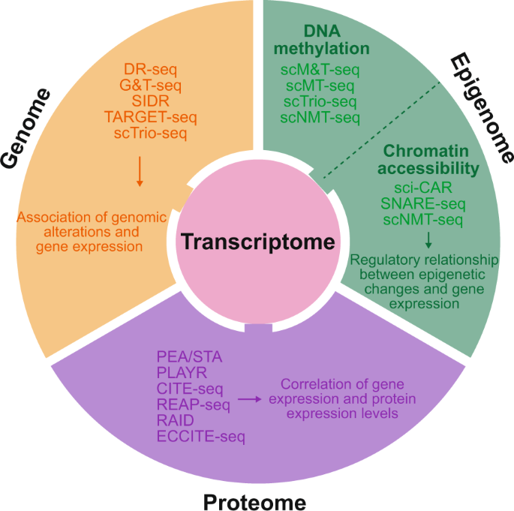
Multi-omics Analysis
Integration and analysis of multiple omics data
Transcriptome (RNA), epigenomics (DNA), proteomics (protein)
Ex: scRNA-seq and scATAC-seq
Explore heterogeneity from different “angles”
Ability to link interactions of DNA, RNA and protein data
https://www.nature.com/articles/s12276-020-0420-2#:~:text=The%20core%20components%20of%20single,cell%20types%20and%20their%20functions
Slide 28
Notes:
Read first major bullet points
Explain figure on right
Read second major bullet points

Slide 29
Multi-omics Analysis
Strategies
Correlation analysis among individual omics data
Analysis of one type of data followed by integration of another type of data
Integrative analysis of all types of data to generate overall map
Tools (for 3rd strategy):
LIGER
Seurat
MOFA
Slide 29
Notes:
Read all bullet points

Slide 30
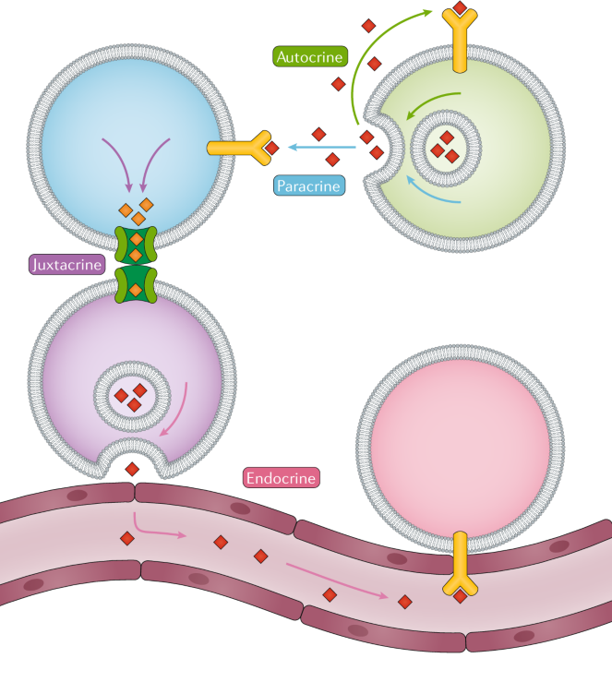
Ligand-Receptor Analysis
Studying ligand-receptor (LR) interactions allows us to learn more about cell communications
With scRNA-seq, we can infer what cell types interact/communicate in a system
Differentiation and organ development
Cell-type communication in tissue and organ homeostasis
Immune interactions in diseases
https://www.nature.com/articles/s41576-020-00292-x
Slide 30
Notes:
Read first major bullet point
Explain plot on right
Read second major bullet points

Slide 31
Ligand-Receptor Analysis
Workflow:
Calculate a “communication” score based on LR list between 2 cell types
Will do this for every cell type pair there is in dataset
Analyze scores with visualization and tables
Plots = Networks, circos, etc.
LR databases
Lewis Lab (UCSD), CellPhoneDB, CellChat, ICELLNET
Tools
CellPhoneDB, CellChat, ICELLNET, my own “tool”, etc.
Slide 31
Notes:
Read all bullet points

Slide 32
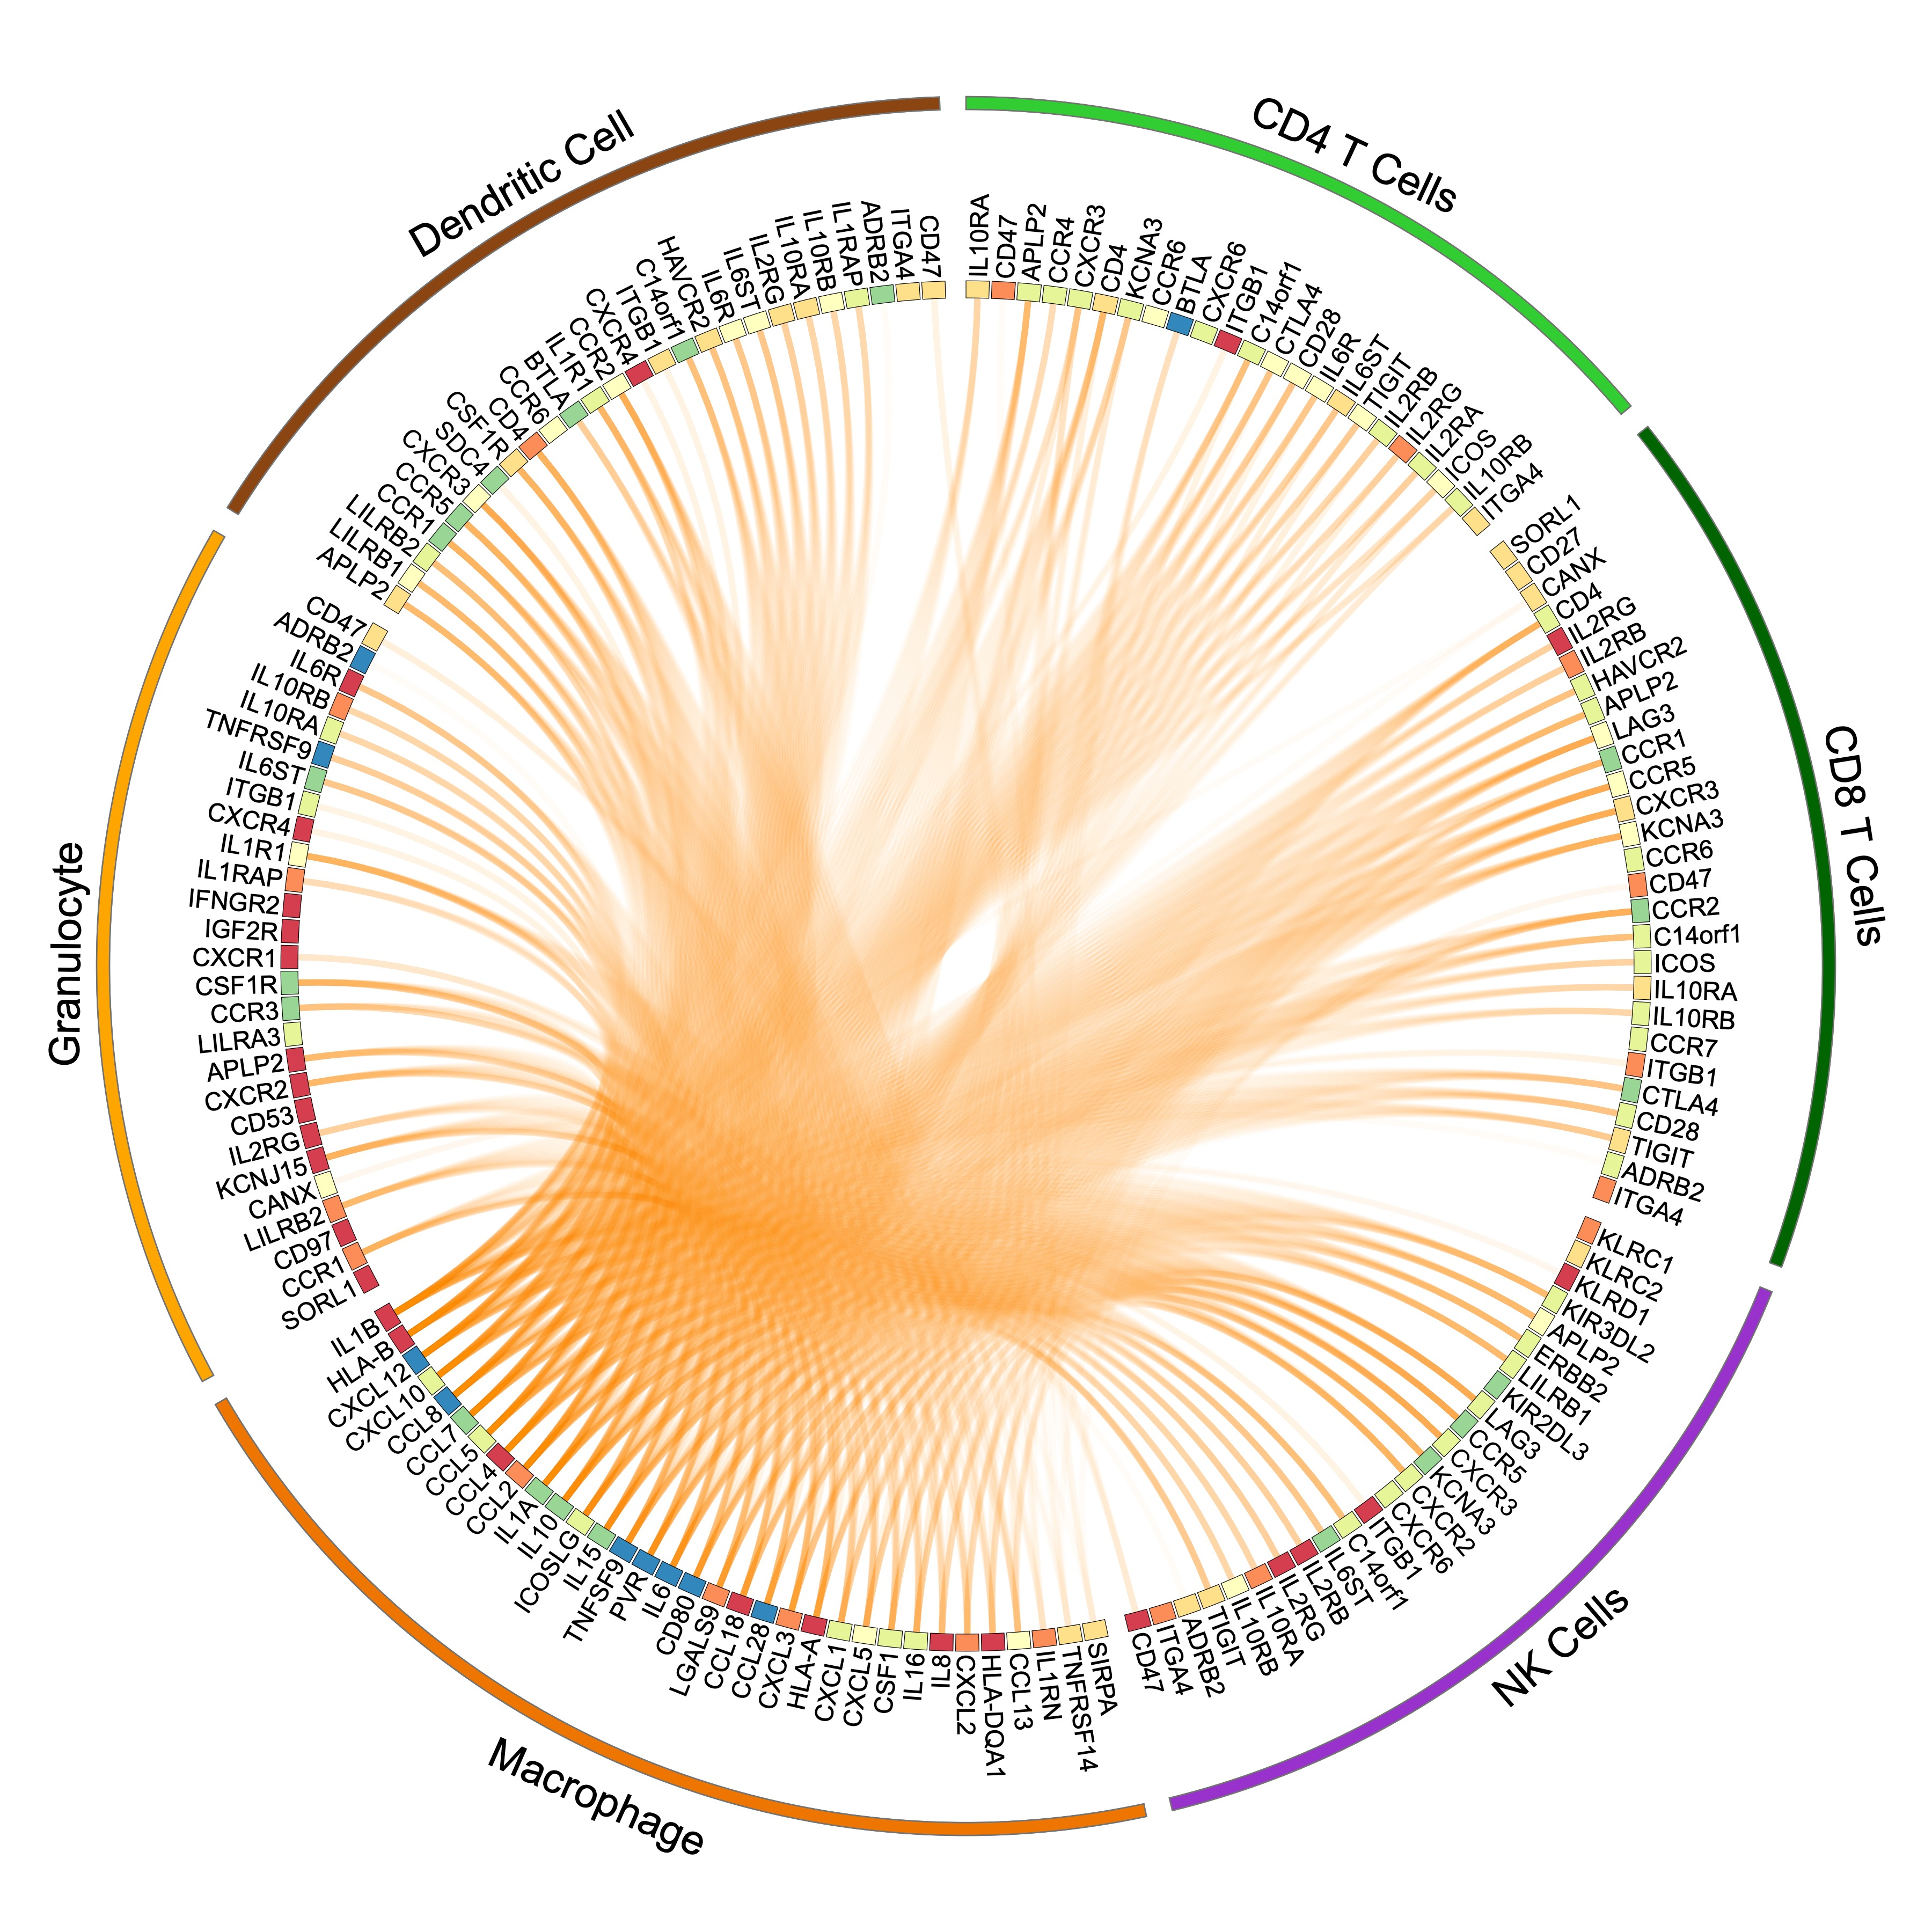
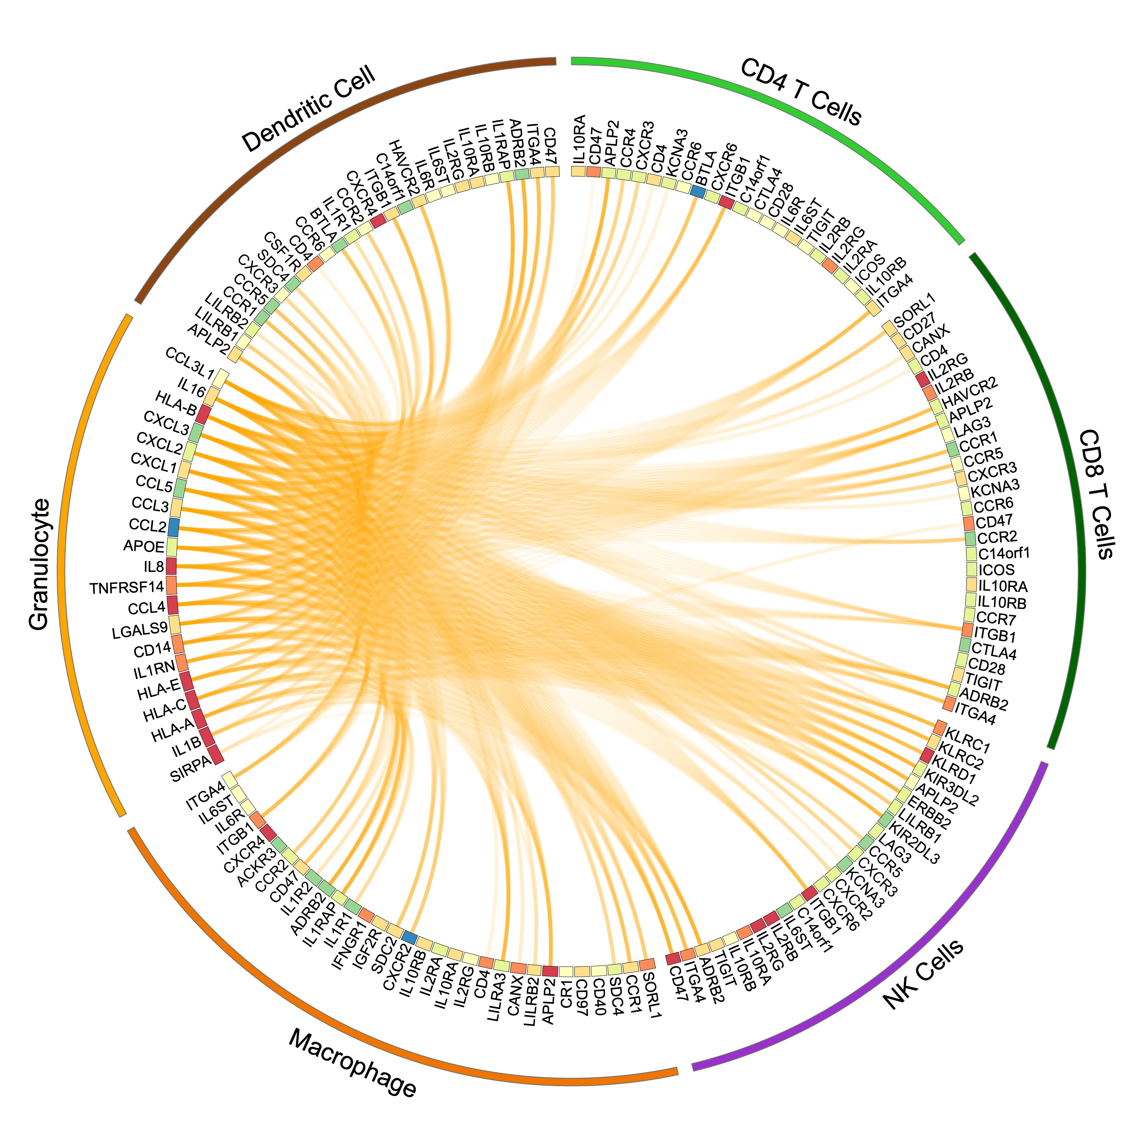
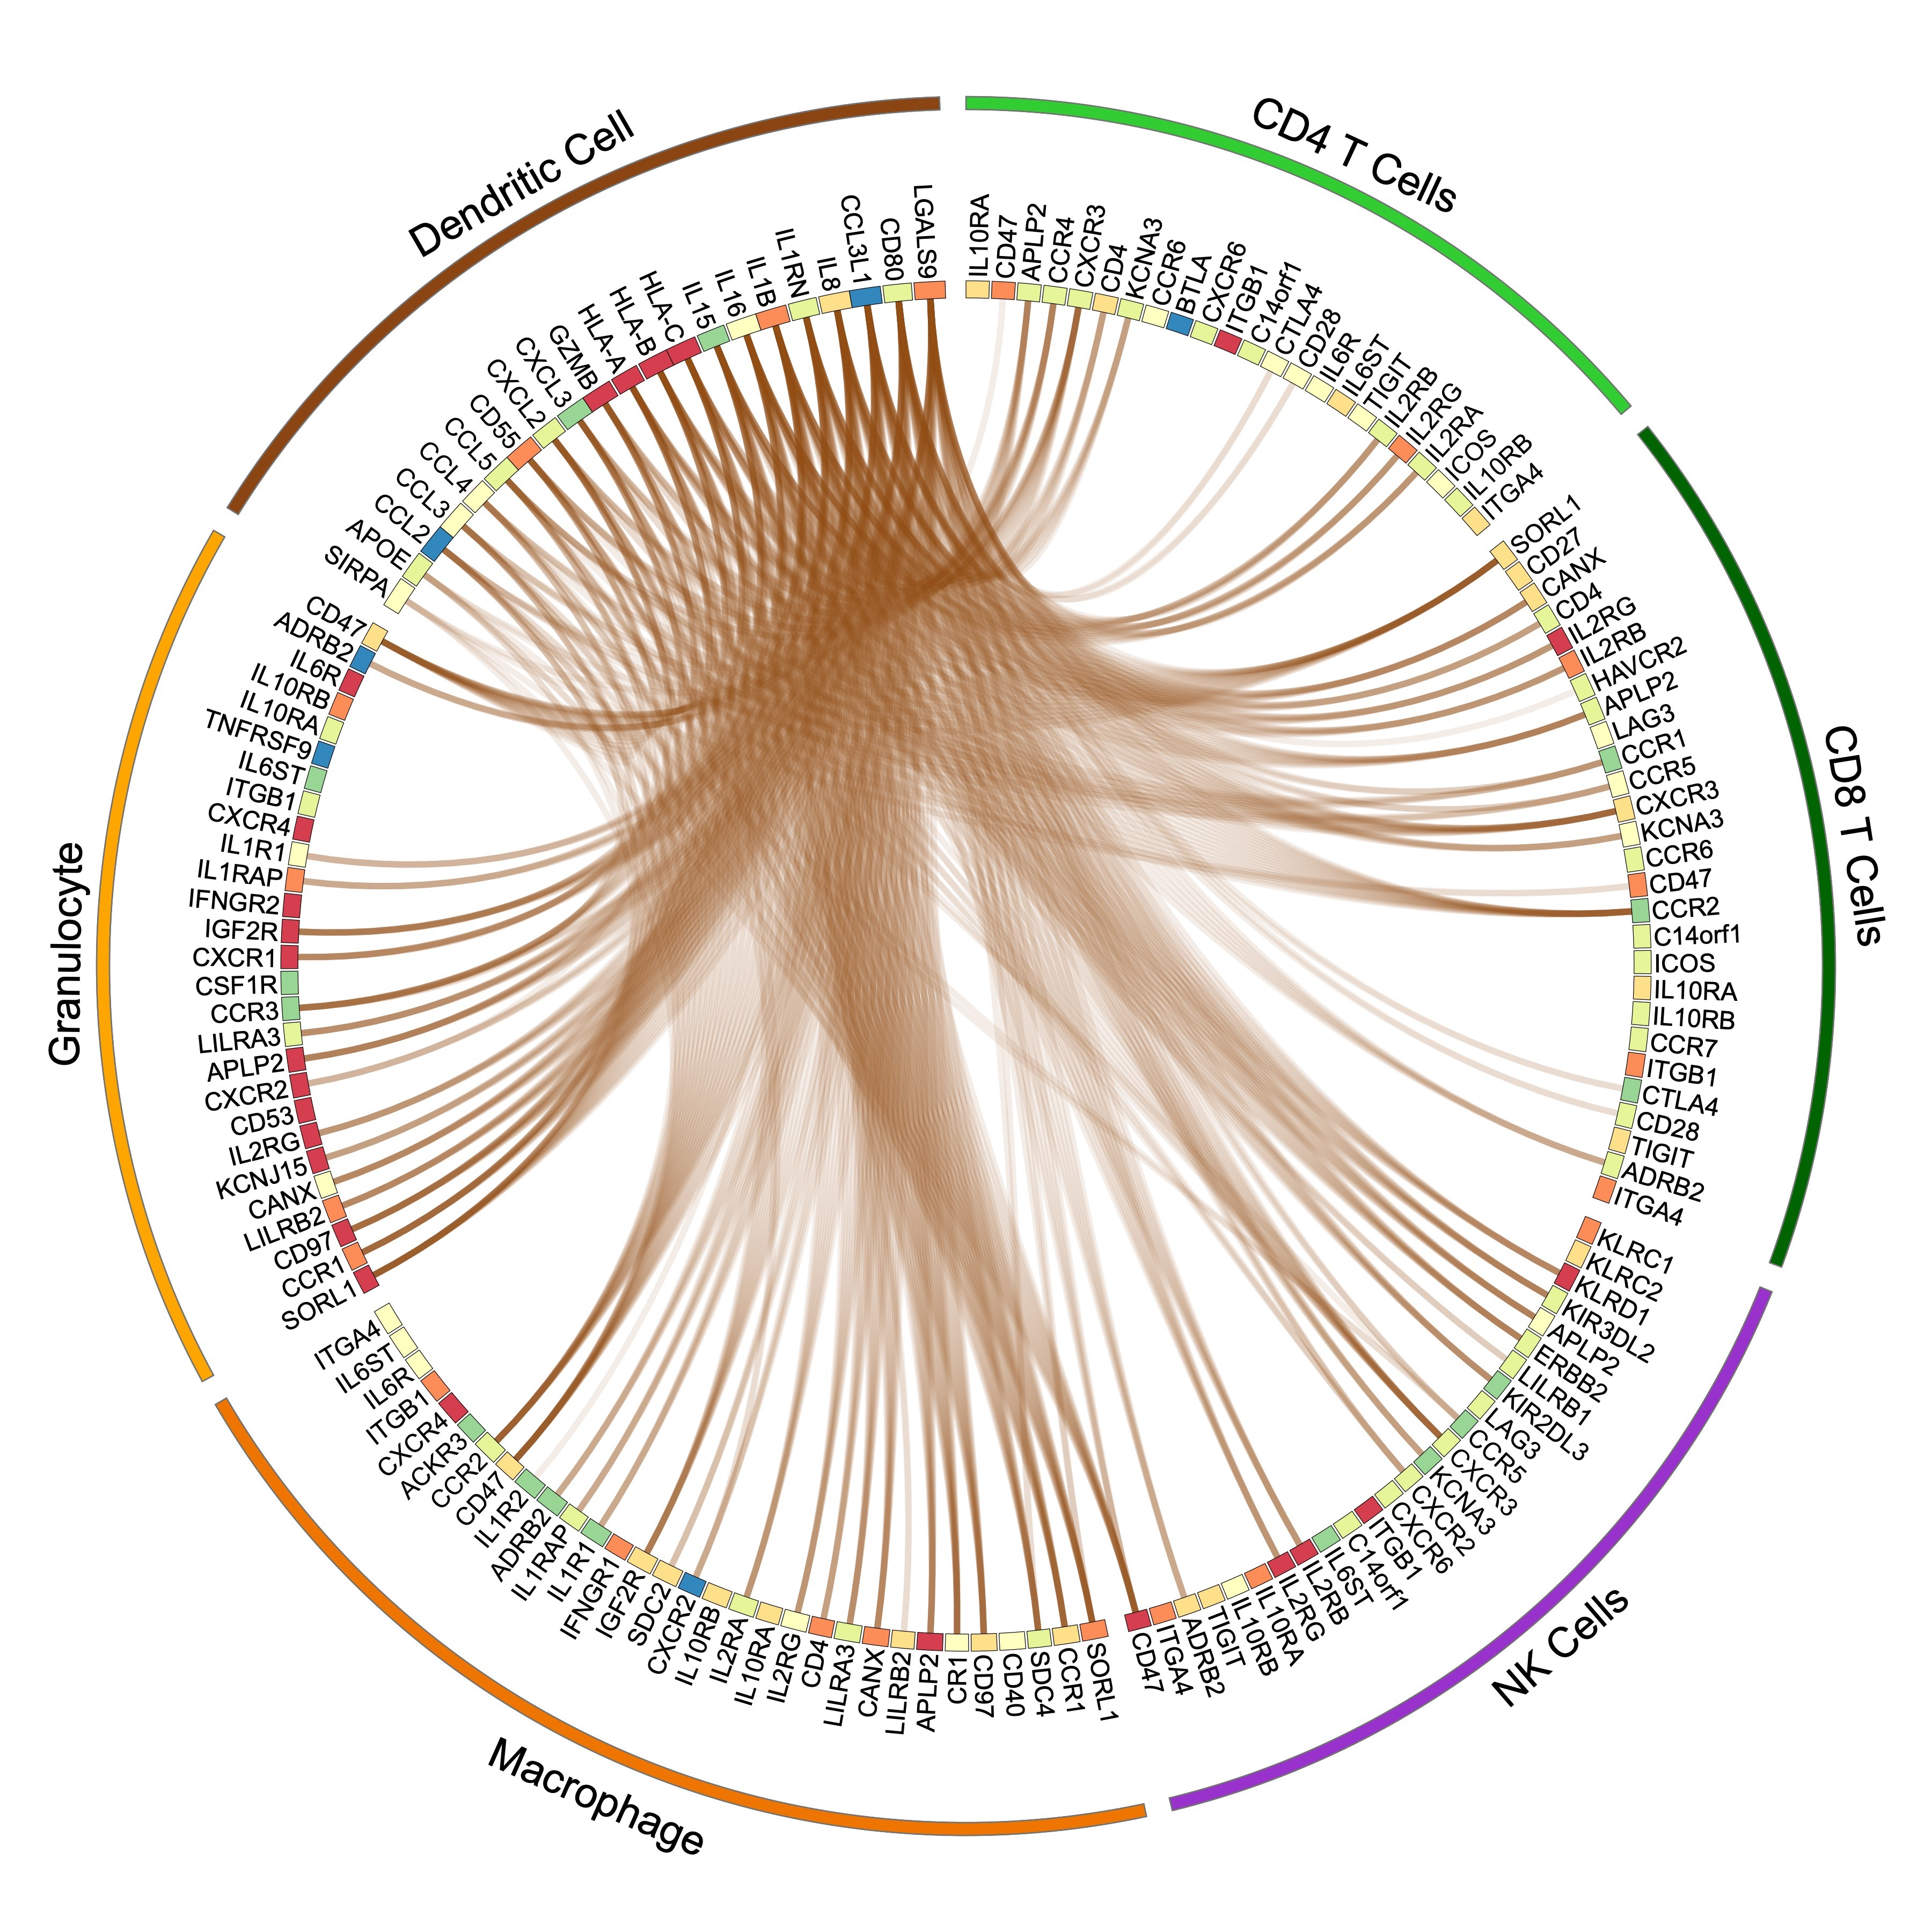
Ligand-Receptor Analysis
Interactomes (circos plots) from dataset’s article
Scaled Expression
A
B
C
LR Interactions with macrophages
LR Interactions with granulocytes
LR Interactions with dendritic cells
Slide 32
https://doi.org/10.1038/s43018-020-00121-4
Notes:
Talk about tool that created for paper
Explain circos plots

Slide 33
Concluding Remarks
Many ways to analyze data after processing the data with the main pipeline
If need help with these analyses:
Consult a bioinformatician
Look at the tool’s manuals
Slide 33
Notes:
Read all bullet points

